Slide 1
Module 3

Slide 2

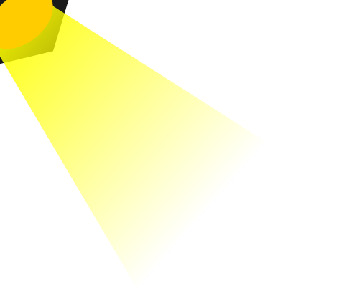
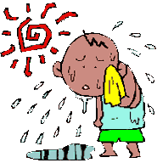
If stimulus is heat
Sunlight
STIMULUS
Response is sweating
RESPONSE

Slide 3
Stimulus is any change in the external environment and all organisms should respond to stimulus
For every stimulus there is a different response
If stimulus is cold
STIMULUS
Response is shivering
RESPONSE

Slide 4


Control
Coordination
Control & coordination are required for proper growth and development of an organism
Why is control and co-ordination required ?
Control refers to the systematic regulation of various activities
Coordination means the orderly execution of the activities.
Let us see some examples of control and co-ordination in plants and animals

Slide 5
Thank You

